Slide 1

Heterogeneous System Architecture (HSA) and the software ecosystem
Hanjin Chu, Director, Heterogeneous solutions, AMD China

Slide 2
cuda brings performance to pro/research on discrete gpu
2006 | 2007 | 2008 | 2009 | 2010 | 2011 | 2012 |
1.5M downloads
1200+ Apps
Adoption
150K+ downloads
500+ Apps*
CUDA Announced
* <5% Consumer
20+% Professional
70+% Research
CUDA gave developers access to unprecedented performance
Not easy to use …but enough performance-hungry developers willing to endure pain
Low Consumer space adoption … esp. due to lack of cross-platform

Slide 3
the runaway success of java
1996 | 1999 | 2002 | 2005 | 2008 | 2011 |
Java 7
10M+ developers
Milllions of Apps
Java SE 6
6M developers
Adoption
J2SE 5.0
4.5M developers
JDK1.0
Truly cross platform – Write Once Run Anywhere
Easy to program
Lack of performance efficiency offset by platform capability

Slide 4
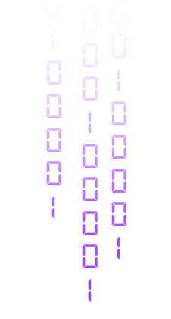
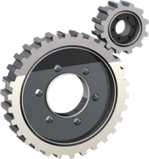
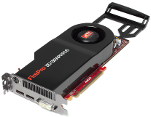
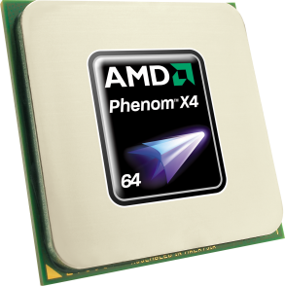
Current Heterogeneous system: CPU+dGPU
NUMA based CPU + GPU can reach high performance but
  Memory Copy always Power Consumption
  System Cost always high and not flexible
Graphics Workloads
Serial/Task-Parallel Workloads
Other Highly Parallel Workloads

Slide 5
Opencl’s cross-platform appeal on APU/dGPU
2006 | 2007 | 2008 | 2009 | 2010 | 2011 | 2012 |
300K+ downloads
100+ Apps
Adoption
35k+ downloads
11 Llano launch Apps
OpenCL 1.1
SDK 2.2
OpenCL 1.0 Announced
Abundant performance + same complexity as CUDA programming
Cross platform resonates with developers (needs per-platform optimization)

Slide 6
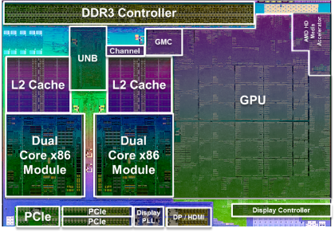
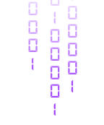

Innovation: HSA – CPU and GPU under UMA
HSA: Heterogeneous System Architecture
Unified memory Model
Intractability between CPU and GPU
Co-processor not Accelerator
CPU and GPU in FUSION SoC
Graphics Workloads
Data Parallel Workloads
Serial and Task Parallel Workloads

Slide 7
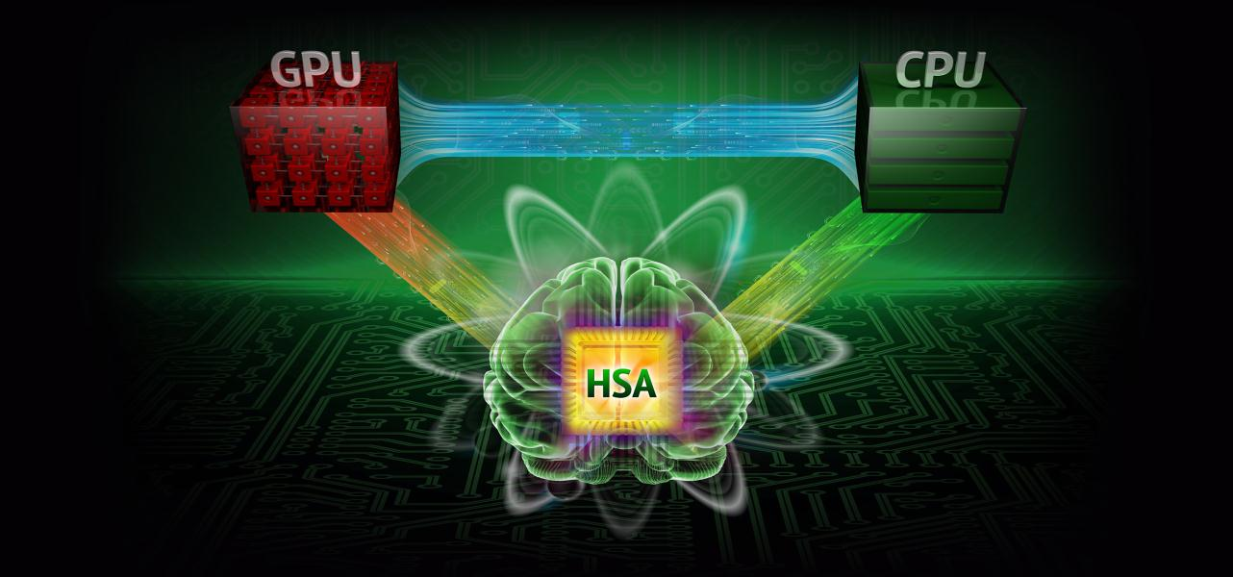
What is HSA?
An intelligent computing architecture that enables CPU, GPU and other processors to work in harmony on a single piece of silicon by seamlessly moving the right tasks to the best suited processing element
hUMA (MEMORY)
PARALLEL
WORKLOADS
SERIAL
WORKLOADS
APU
ACCELERATED PROCESSING UNIT
Notes:
HSA will empower software developers to easily innovate and unleash new levels of performance and functionality on all your modern devices and lead to powerful new experiences such as visually rich, intuitive, human-like interactivity.

Slide 8
And designed beyond GPU
Dedicated Processor/Engine becoming co-processor
Full Programming language support
User Mode Queueing
Heterogeneous Unified Memory Access (hUMA)
Pageable Memory
Bidirectional coherency
Compute context switch and preemption
CPU
Audio
Processor
Video
Hardware
Encode
Decode
Engines
Shared Memory, Coherency, User Mode Queues
GPU
Fixed
Function
Accelerator
DSP
Image
Signal Processing
Notes:
Inclusive of fixed function devices and all programmable devices in a SOC.
The hardware architecture which brings the platform to the programmer. The hardware removes the nits that have nagged programmers for yeas. Each feature of the hardware is make programmability, perf and power better.
Shared page table support: To simplify OS and user software, HSA allows a single set of page table entries to be shared between LCUs and TCUs. This allows units of both types to access memory through the same virtual address. The system is further simplified in that the operating system only needs to manage one set of page tables. This enables Shared Virtual Memory (SVM) semantics between LCU and TCU.
Operating systems allow user processes to access more memory than is physically addressable by paging memory to and from disk. Early TCU hardware only allowed access to pinned memory, meaning that the driver invoked an OS call to prevent the memory from being paged out. In addition, the OS and driver had to create and manage a separate virtual address space for the TCU to use. HSA removes the burdens of pinned memory and separate virtual address management, by allowing compute units to page fault and to use the same large address space as the CPU.
User-level command queuing. Time spent waiting for OS kernel services was often a major performance bottleneck in prior throughput computing systems. HSA drastically reduces the time to dispatch work to the TCU by enabling a dispatch queue per application and by allowing user mode process to dispatch directly into those queues, requiring no OS kernel transitions or services. This makes the full performance of the platform available to the programmer, minimizing software driver overheads
Coherent memory regions. In traditional GPU devices, even when the CPU and GPU are using the same system memory region, the GPU uses a separate address space from the CPU, and the graphics driver must flush and invalidate GPU caches at required intervals in order for the CPU and GPU to share results. HSA embraces a fully coherent shared memory model, with unified addressing. This provides programmers with the same coherent memory model that they enjoy on SMP CPU systems. This enables developers to write applications that closely couple LCU and TCU codes in popular design patterns like producer-consumer. The coherent memory heap is the default heap on HSA and is always present. Implementations may also provide a non-coherent heap for advance programmers to request when they know there is no sharing between processor types
The software stack is to deliver on that promise. Split compilation, high data and command flow paths (big improvement over legacy), KMD and Runtime needed for initialization, tear down, Bulk of developers will access through libraries which are optimized
Many compute problems today require much larger memory spaces than can be provided by traditional GPUs, whether we are discussing the local memory of a discrete GPU or the pinned system memory used by an APU. Partitioning a program to repeatedly use a small memory pool can require a huge programming effort, and for that reason large workloads often are not ported onto the GPU. Allowing the HSA throughput engine to use the same pageable virtual address space as the CPU, allows problems to be easily ported to an HSA system without extra coding effort. This significantly increases computational performance of programs requiring very large data sets.
In addition, a unified address space allows data structures containing pointers (such as linked lists and various forms of tree and graph structures) to be freely used by both LCUs and TCUs. Today, such data structures require special handling by the programmer, and often are the main reason why certain algorithms cannot be ported to a GPU. With HSA, this is handled transparently.

Slide 9
HSA SW Stack changing programming model
components:
Compliant heterogeneous computing hardware
A software compilation stack
A user - space runtime system
Kernel - space system components
Overall Vision:
Make GPU easily accessible
  Support mainstream languages
  Expandable to domain specific languages
Make compute offload efficient
  Direct path to GPU (avoid Graphics overhead)
  Eliminate memory copy
  Low-latency dispatch
Make it ubiquitous
  Drive HSA as a standard through HSA Foundation
  Open Source key components
Application
Domain Specific Libs
(Bolt, OpenCV™, … many others)
Application SW
OpenCL™ Runtime
DirectX
Runtime
Other Runtime
HSA Runtime
Legacy
Drivers
HSA Software
HSAIL
Drivers
HSA Finalizer
GPU ISA
CPU(s)
GPU(s)
Other Accelerators
Differentiated HW
Notes:
With HSA, there is an alternate path to the accelerators in the system, besides the legacy driver model.
We are moving beyond the platform architecture of the last 25 years, to unlock software innovation for modern workloads.
Applications will be able to deliver work *directly* to the queues fetched by the parallel processor in the GPU.
We abstract the parallel processor with a new virtual ISA, called HSAIL. A low level IL that allows multiple hardware vendors to continue to innovate within a standard platform. There is a “finalizer” between the HSAIL generated by the high level compiler and the GPU ISA. The architecture supports the finalizer being run at multiple possible times: at run time, install time or compile time, depending on the target platform.
Overall Vision:
Make GPU easily accessible
Support mainstream languages
Expandable to domain specific languages
Make compute offload efficient
Direct path to GPU (avoid Graphics overhead)
Eliminate memory copy
Low-latency dispatch
Make it ubiquitous
Drive HSA as a standard through HSA Foundation
Open Source key components

Slide 10




HSA OBJECTIVE
New
User
Experiences
More
Performance
@
Lower Power
Heterogeneous
System
Architecture
Small
Form
Factors
HSA creates an improved processor design that exposes the benefits and capabilities of mainstream programmable compute elements, working together seamlessly.

Slide 11






























HSA foundation : Driving Future of Heterogeneous Computing standard
Founders
Promoters
Supporters
Contributors
Academic
Notes:
The HSA Foundation is an industry standards body that has gained significant traction in a very short time. Developing standards so that developers and OSVs program HSA platforms easily and get good power/performance and become more aggressive in developing new applications knowing that certain features are required

Slide 12
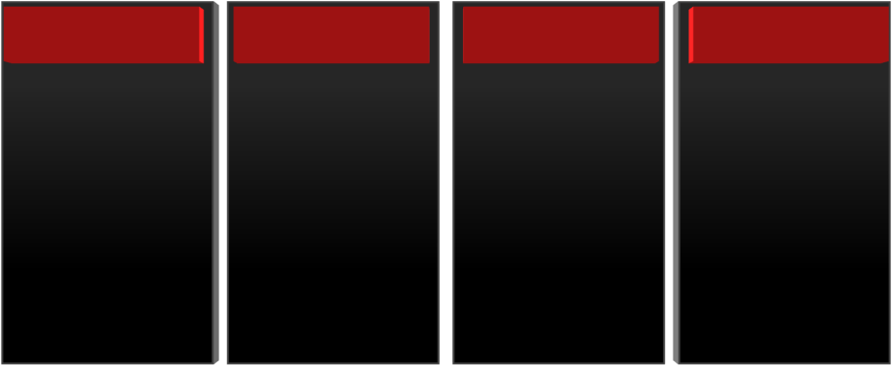
AMD HSA roadmap
Physical Integration
Optimized
Platforms
Architectural
Integration
System
Integration
Integrate CPU & GPU
in silicon
GPU Compute C++ support
Unified Address Space for CPU and GPU
GPU compute
context switch
Unified Memory Controller
User mode scheduling
GPU uses pageable system memory via CPU pointers
GPU graphics
pre-emption
Common Manufacturing Technology
Bi-Directional Power Mgmt between CPU and GPU
Fully coherent memory between CPU & GPU
Quality of Service
Notes:
Each year, the APU will improve as these features come on line.
At the end of this sequence, the GPU is a true peer processor to the CPU, with direct access by software.
12

Slide 13


What is hUMA? heterogeneous
Uniform memory access

Slide 14
UNDERSTANDING UMA
Original meaning of UMA is Uniform Memory Access
  Refers to how processing cores in a system view and access memory
  All processing cores in a true UMA system share a single memory address space
Introduction of GPU compute created systems with Non-Uniform Memory Access (NUMA)
  Require data to be managed across multiple heaps with different address spaces
  Add programming complexity due to frequent copies, synchronization, and address translation
HSA restores the GPU to Uniform memory Access
  Heterogeneous computing replaces GPU Computing

Slide 15
INTRODUCING hUMA
UMA
Memory
CPU
CPU
CPU
CPU
CPU
NUMA
CPU Memory
GPU Memory
APU
CPU
CPU
CPU
CPU
GPU
GPU
GPU
GPU
hUMA
APU
with
HSA
Memory
CPU
CPU
CPU
CPU
GPU
GPU
GPU
GPU

Slide 16
hUMA KEY FEATURES
BI-DIRECTIONAL COHERENT MEMORY
  Any updates made by one processing element will be seen by all other processing elements - GPU or CPU
PAGEABLE MEMORY
GPU can take page faults, and is no longer restricted to page locked memory
ENTIRE MEMORY SPACE
CPU and GPU processes can dynamically allocate memory from the entire memory space

Slide 17
hUMA KEY FEATURES
Coherent Memory:
Ensures CPU and GPU
caches both see
an up-to-date view of data
CPU
GPU
Cache
HW
Coherency
Cache
Pageable memory:
The GPU can seamlessly
access virtual memory
addresses that are not (yet)
present in physical memory
Physical Memory
Virtual Memory
Entire memory space:
Both CPU and GPU can access and allocate any location in the system’s virtual memory space

Slide 18
WITHOUT POINTERS* AND DATA SHARING
Without hUMA:
CPU explicitly copies data to GPU memory
GPU completes computation
CPU explicitly copies result back to CPU memory
CPU
GPU
CPU Memory
GPU Memory
Only the data array
can be copied since GPU cannot follow embedded
data-structure links
| | | | |
| | | | |
| | | | |
| | | | |
*A Pointer is a named variable that holds a memory address. It makes it easy to reference data or code segments by a name and eliminates the need for the developer to know the actual address in memory. Pointers can be manipulated by the same expressions used to operate on any other variable

Slide 19
WITH POINTERS* AND DATA SHARING
With hUMA:
CPU simply passes a pointer to GPU
GPU completes computation
CPU can read the result directly – no copying needed!
CPU
GPU
CPU / GPU Uniform Memory
CPU can pass a pointer to entire data structure since the GPU can now follow embedded links
| | | | |
| | | | |
*A Pointer is a named variable that holds a memory address. It makes it easy to reference data or code segments by a name and eliminates the need for the developer to know the actual address in memory. Pointers can be manipulated by the same expressions used to operate on any other variable

Slide 20
TOP 10 DRIVING HARDWARE COHERENT ON GPU/APU
Much easier for programmers
No need for special APIs
Move CPU multi-core algorithms to the GPU without recoding for absence of coherency
Allow finer grained data sharing than software coherency
Implement coherency once in hardware, rather than N times in different software stacks
Prevent hard to debug errors in application software
Operating systems prefer hardware coherency – they do not want the bug reports to the platform
Probe filters and directories will maintain power efficiency
Full coherency opens the doors to single source, native and managed code programming for heterogeneous platforms
Optimal architecture for heterogeneous computing on APUs and SOCs
AMD Confidential, under embargo until Apr 30, 12:01 AM EST

Slide 21
hUMA features
☑
Access to Entire Memory Space
☑
Pageable memory
☑
Bi-directional Coherency
☑
Fast GPU access to system memory
☑
Dynamic Memory Allocation

Slide 22

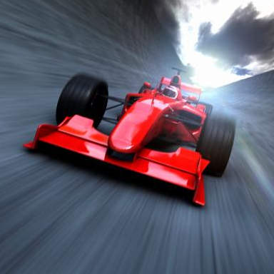
HSA programming model

Slide 23
What is HSA
Heterogeneous System Architecture
  Efficiently support a wide assortment of data-parallel and task-parallel programming models
  Provides a unified view of fundamental computing elements
  Allows a programmer to write applications that seamlessly integrate
      CPUs (called latency compute units)
      GPUs (called throughput compute units)
Notes:
GPUs have transitioned in recent years from pure graphics accelerators to more general-purpose parallel processors, supported by standard APIs and tools such as OpenCL and DirectCompute . Those APIs are a promising start, but many hurdles remain for the creation of an environment that allows the GPU to be used as fluidly as the CPU for common programming tasks: different memory spaces between CPU and GPU, non-virtualized hardware, and so on. HSA removes those hurdles, and allows the programmer to take advantage of the parallel processor in the GPU as a peer or co-processor to the traditional multi-threaded CPU.

Slide 24
HSA Taking Platform to Programmers
Balance between CPU and GPU for performance and power efficiency
Make GPUs accessible to wider audience of programmers
  Programming models close to today’s CPU programming models
  Enabling more advanced language features on GPU
  Shared virtual memory enables complex pointer-containing data structures (lists, trees, etc.) and hence more applications on GPU
  Kernel can enqueue work to any other device in the system (e.g. GPU->GPU, GPU->CPU)
    Enabling task-graph style algorithms, Ray-Tracing, etc
Clearly defined HSA memory model enables effective reasoning for parallel programming
HSA provides a compatible architecture across a wide range of programming models and HW implementations.

Slide 25
Improve Performance and Reduce Power
Pass pointers rather than copying memory
  Eliminate power and time associated with data copies
Reduce kernel launch time
  User-mode queuing
    Avoid OS kernel transitions when commands are sent to the GPU
  “Architected Queuing Language”
    Stable, architected, heterogeneous compute engine command language
Optimizing GPU compute compiler
  Optimizations done in single compiler (rather than 2-3 today)
  High-Level compiler performs optimizations and generates HSAIL
  Finalize converts HSAIL to target ISA – focused on correctness and compilation speed

Slide 26
Recap HSA SW Stack
components:
Compliant heterogeneous computing hardware
A software compilation stack
A user - space runtime system
Kernel - space system components
Overall Vision:
Make GPU easily accessible
  Support mainstream languages
  Expandable to domain specific languages
Make compute offload efficient
  Direct path to GPU (avoid Graphics overhead)
  Eliminate memory copy
  Low-latency dispatch
Make it ubiquitous
  Drive HSA as a standard through HSA Foundation
  Open Source key components
Application
Domain Specific Libs
(Bolt, OpenCV™, … many others)
Application SW
OpenCL™ Runtime
DirectX
Runtime
Other Runtime
HSA Runtime
Legacy
Drivers
HSA Software
HSAIL
Drivers
HSA Finalizer
GPU ISA
CPU(s)
GPU(s)
Other Accelerators
Differentiated HW
Notes:
With HSA, there is an alternate path to the accelerators in the system, besides the legacy driver model.
We are moving beyond the platform architecture of the last 25 years, to unlock software innovation for modern workloads.
Applications will be able to deliver work *directly* to the queues fetched by the parallel processor in the GPU.
We abstract the parallel processor with a new virtual ISA, called HSAIL. A low level IL that allows multiple hardware vendors to continue to innovate within a standard platform. There is a “finalizer” between the HSAIL generated by the high level compiler and the GPU ISA. The architecture supports the finalizer being run at multiple possible times: at run time, install time or compile time, depending on the target platform.
Overall Vision:
Make GPU easily accessible
Support mainstream languages
Expandable to domain specific languages
Make compute offload efficient
Direct path to GPU (avoid Graphics overhead)
Eliminate memory copy
Low-latency dispatch
Make it ubiquitous
Drive HSA as a standard through HSA Foundation
Open Source key components

Slide 27
HSA
Architecture
HSA Software Stack
Apps
Apps
Apps
Apps
Apps
Apps
GPU compute C++ support
User Mode Scheduling
Fully coherent memory between CPU & GPU
GPU uses pageable system memory via CPU pointers
GPU graphics pre-emption
GPU compute context switch
HSA Domain Libraries,
OpenCL ™ 2.x Runtime
HSA Runtime
HSA JIT
Task Queuing Libraries
HSA Kernel
Mode Driver
Shared Memory Coherency, User Mode Queues
CPU
Audio
Processor
Encode
Decode
Video
Hardware
GPU
Fixed
Function
Acctr
DSP
Image
Signal Processing
Notes:
The hardware architecture which brings the platform to the programmer. The hardware removes the nits that have nagged programmers for yeas. Each feature of the hardware is make programmability, perf and power better.
Shared age table support: To simplify OS and user software, HSA allows a single set of page table entries to be shared between LCUs and TCUs. This allows units of both types to access memory through the same virtual address. The system is further simplified in that the operating system only needs to manage one set of page tables. This enables Shared Virtual Memory (SVM) semantics between LCU and TCU.
Operating systems allow user processes to access more memory than is physically addressable by paging memory to and from disk. Early TCU hardware only allowed access to pinned memory, meaning that the driver invoked an OS call to prevent the memory from being paged out. In addition, the OS and driver had to create and manage a separate virtual address space for the TCU to use. HSA removes the burdens of pinned memory and separate virtual address management, by allowing compute units to page fault and to use the same large address space as the CPU.
User-level command queuing. Time spent waiting for OS kernel services was often a major performance bottleneck in prior throughput computing systems. HSA drastically reduces the time to dispatch work to the TCU by enabling a dispatch queue per application and by allowing user mode process to dispatch directly into those queues, requiring no OS kernel transitions or services. This makes the full performance of the platform available to the programmer, minimizing software driver overheads
Coherent memory regions. In traditional GPU devices, even when the CPU and GPU are using the same system memory region, the GPU uses a separate address space from the CPU, and the graphics driver must flush and invalidate GPU caches at required intervals in order for the CPU and GPU to share results. HSA embraces a fully coherent shared memory model, with unified addressing. This provides programmers with the same coherent memory model that they enjoy on SMP CPU systems. This enables developers to write applications that closely couple LCU and TCU codes in popular design patterns like producer-consumer. The coherent memory heap is the default heap on HSA and is always present. Implementations may also provide a non-coherent heap for advance programmers to request when they know there is no sharing between processor types
The software stack is to deliver on that promise. Split compilation, high data and command flow paths (big improvement over legacy), KMD and Runtime needed for initialization, tear down, Bulk of developers will access through libraries which are optimized
Many compute problems today require much larger memory spaces than can be provided by traditional GPUs, whether we are discussing the local memory of a discrete GPU or the pinned system memory used by an APU. Partitioning a program to repeatedly use a small memory pool can require a huge programming effort, and for that reason large workloads often are not ported onto the GPU. Allowing the HSA throughput engine to use the same pageable virtual address space as the CPU, allows problems to be easily ported to an HSA system without extra coding effort. This significantly increases computational performance of programs requiring very large data sets.
In addition, a unified address space allows data structures containing pointers (such as linked lists and various forms of tree and graph structures) to be freely used by both LCUs and TCUs. Today, such data structures require special handling by the programmer, and often are the main reason why certain algorithms cannot be ported to a GPU. With HSA, this is handled transparently.

Slide 28

HSA Intermediate Language - HSAIL
Designed for C99, C++ 2011, Java, Renderscript, OpenCL, C++ AMP
HSAIL is a virtual ISA for parallel programs
  Finalized to ISA by a JIT compiler or “Finalizer”
  ISA independent by design for CPU & GPU
Explicitly parallel
  Designed for data parallel programming
Support for exceptions, virtual functions,
and other high level language features
Syscall methods
  GPU code can call directly to system services, IO, printf, etc
Notes:
Lets take a deeper dive here into the details of the architecture …

Slide 29

OpenCL™ and HSA
HSA is an optimized platform architecture for OpenCL™
  Not an alternative to OpenCL™
OpenCL™ on HSA will benefit from
  Avoidance of wasteful copies
  Low latency dispatch
  Improved memory model
  Pointers shared between CPU and GPU
HSA also exposes a lower level programming interface, for those that want the ultimate in control and performance
  Optimized libraries may choose the lower level interface

Slide 30
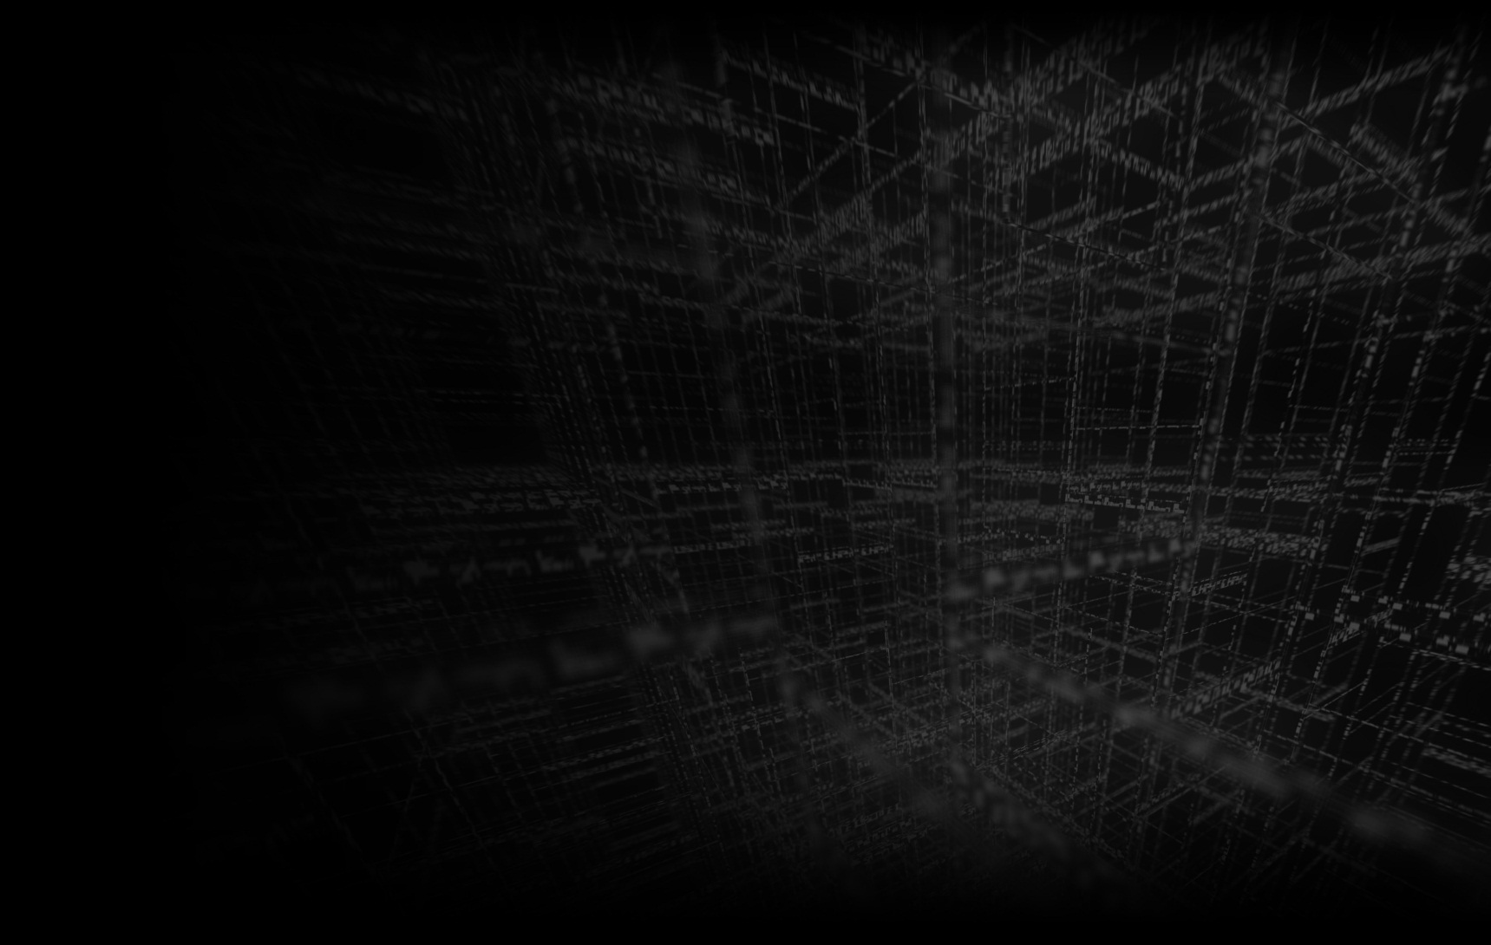
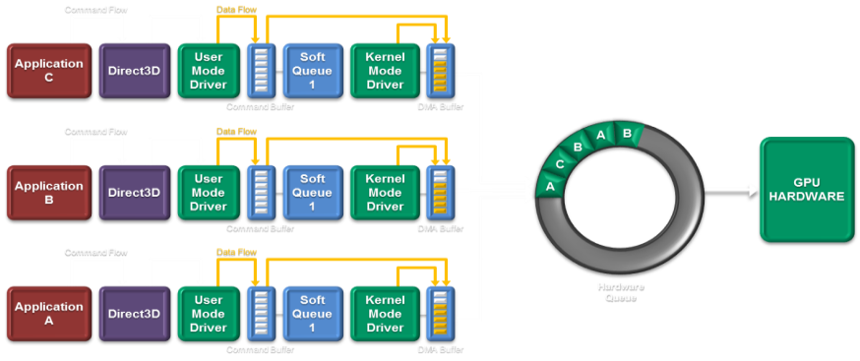
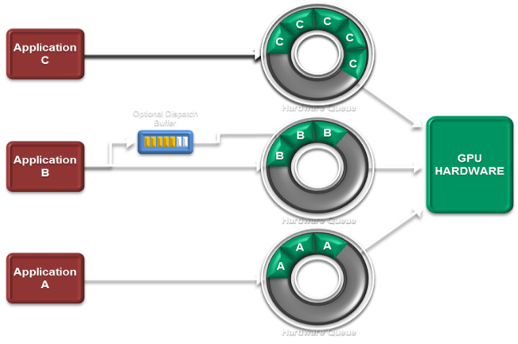
Heterogeneous Compute Dispatch
How compute dispatch operates today in the driver model
How compute dispatch improves under HSA
Notes:
How many of you came by plane to this conference.
What goes through your mind each time you experience TSA security?
The flow stinks!
I am an engineer – I could optimize this, so simply – its what we do
Except for a large government bureaucracy in the way …
Have you ever thought about compute dispatch that way?

Slide 31


Today’s Command and Dispatch Flow
Command Flow
Data Flow
Application A
Direct3D
User Mode Driver
Soft Queue
Kernel Mode Driver
Command Buffer
DMA Buffer
GPU HARDWARE
A
Hardware Queue

Slide 32
Today’s Command and Dispatch Flow
Command Flow
Data Flow
Application A
Direct3D
User Mode Driver
Soft Queue
Kernel Mode Driver
Command Buffer
DMA Buffer
Command Flow
Data Flow
GPU HARDWARE
Application B
Direct3D
User Mode Driver
Soft Queue
Kernel Mode Driver
A
Command Buffer
DMA Buffer
Command Flow
Data Flow
Hardware Queue
Application C
Direct3D
User Mode Driver
Soft Queue
Kernel Mode Driver
Command Buffer
DMA Buffer

Slide 33
Today’s Command and Dispatch Flow
Command Flow
Data Flow
Application A
Direct3D
User Mode Driver
Soft Queue
Kernel Mode Driver
Command Buffer
DMA Buffer
Command Flow
Data Flow
A
B
B
GPU HARDWARE
C
Application B
Direct3D
User Mode Driver
Soft Queue
Kernel Mode Driver
A
Command Buffer
DMA Buffer
Command Flow
Data Flow
Hardware Queue
Application C
Direct3D
User Mode Driver
Soft Queue
Kernel Mode Driver
Command Buffer
DMA Buffer

Slide 34
Today’s Command and Dispatch Flow
Command Flow
Data Flow
Application A
Direct3D
User Mode Driver
Soft Queue
Kernel Mode Driver
Command Buffer
DMA Buffer
Command Flow
Data Flow
A
B
B
GPU HARDWARE
C
Application B
Direct3D
User Mode Driver
Soft Queue
Kernel Mode Driver
A
Command Buffer
DMA Buffer
Command Flow
Data Flow
Hardware Queue
Application C
Direct3D
User Mode Driver
Soft Queue
Kernel Mode Driver
Command Buffer
DMA Buffer

Slide 35


HSA Command and Dispatch Flow
C
C
Application C
C
C
C
Application codes to the hardware
User mode queuing
Hardware scheduling
Low dispatch times
Optional Dispatch Buffer
Hardware Queue
B
GPU HARDWARE
B
Application B
B
No APIs
No Soft Queues
No User Mode Drivers
No Kernel Mode Transitions
No Overhead!
Hardware Queue
A
A
Application A
A
Hardware Queue

Slide 36

Hsa Command and Dispatch CPU <-> GPU
Click 3 and 4
B to CPU1 (do not delete – part of animation)
CPU1 to B (do not delete – part of animation)
C to CPU2 (do not delete – part of animation)
A to CPU1 (do not delete – part of animation)
App to C (do not delete – part of animation)
App to A (do not delete – part of animation)
B
A
C
D
F
E
G
Application / Runtime
CPU1
CPU2
GPU
Notes:
Now here is how the whole heterogeneous platform works, with CPU and GPU queues, running in harmony.
No bureaucracy here … this is a beautiful thing.

Slide 37
Driver Stack
HSA Software Stack
Apps
Apps
Apps
Apps
Apps
Apps
Apps
Apps
Apps
Apps
Apps
Apps
Domain Libraries
HSA Domain Libraries,
OpenCL ™ 2.x Runtime
OpenCL™ 1.x, DX Runtimes,
User Mode Drivers
HSA Runtime
HSA JIT
Task Queuing Libraries
Graphics Kernel Mode Driver
HSA Kernel
Mode Driver
Hardware - APUs, CPUs, GPUs
User mode component
Kernel mode component
Components contributed by third parties

Slide 38
Quick Look at HSA Compiler Infrastructure
LLVM-RS-CC
Clang –C++ AMP, OpenCL, KL, etc.
Clang - Renderscript
LLVM
-
Optimized Output
Optimized Output
BRIG Binary Object
( Machine Independent Optimized HSAIL)
Optimized BitCode
LibBCC
Link
Library
Finalizer/JIT
Link
Library
Optimized for Fast Compiler Time
Optimized for Fast Compiler Time
LibRS Loader
Loader
Processor
Processor

Slide 39

Securing GPU Resources in the System
GPU now supports a full MMU which allow for User protected execution, protected memory and memory curtaining
  Read, write and execute protections by page table entry
  Brings inter-process protection
  Improved fault handling
The ability to kill errant task on the GPU.

Slide 40
InterOp of HSA and Graphics
OpenGL-ES/EGL can share data with HSA Runtime
  Buffer (Vertex/Pixelbuffer)
  Texture
  Renderbuffer
Mapping
  HSA Image -> OpenGL-ES Texture, renderbuffer
  HSA buffer -> OpenGL-ES buffer
Sync
  Acquire and Release mechanism

Slide 41
Security Improvements with HSA
With HSA, GPU operates in the same security infrastructure as the CPU
  User and privileged memory
  Read, write and execute protections by page table entry
Internally, the GPU partitions functionality by privilege level
  User mode compute queues can only run AQL packets
  User mode graphics command buffers cannot write privileged registers
HSA supports fixed time context switching, which is resistant to denial of service (DoS) attacks
  Today’s GPUs are vulnerable to denial of service attacks
    Long or infinite shader programs
    Full GPU reset required to restore service
  With HSA, fair scheduling and context switching ensures a responsive system

Slide 42
Richer Programing Model Support
Support for Today GPU Programing Model
  Data Parallelism - Embarrassingly Parallel Application
  SPMD – Single Program Multiple Data Based Application
In addition supporting richer set of Parallel Solutions
  Task-Parallelism, Nested-Parallelism, Braided-Parallelism,
  Task-graph style algorithms
Support for Algorithm that need Inter-task Communication.
Application that need exceptions processing
Notes:
http://www.slideshare.net/alexkaratarakis/hybrid-cpugpu-computing-with-domain-decomposition
Efficient with kernels with all traditional memory transfer dependencies
Non-dependent on Host to Device or Device to Host
Dependent –Streaming with Host to Device or Device to Host
Single Dependent- Host to Device or Device to Host
Dual Dependent Host to Device & Device to Host
Look at image to linear, linear to image, image to image, linear to linear memory access as well.

Slide 43
Richer Support of Advanced Algorithms
Visual Search
Feature Extraction
Feature Matching
Geometric Verification
Gesture Recognition
Image Segmentation
Motion Estimation
Computation of Geometry ( shape analysis)
Hidden Markov Model acceleration
Operate on large Markov Random Fields
Computational Photography
  Feature Extraction
  Feature Matching
  Geometric Verification
  Image Stitching
  HDR
  DoF control
  Lightfield Imaging

Slide 44
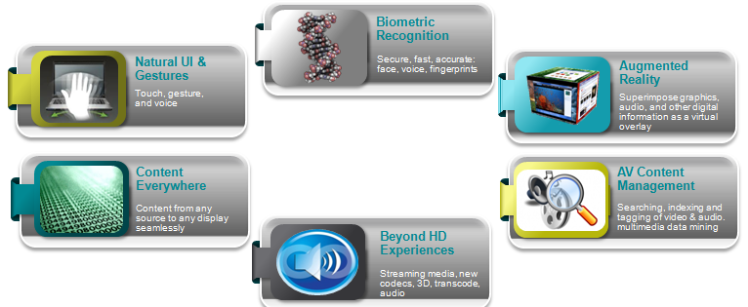
Application Areas with Abundant Parallel Workloads
Notes:
Bringing your fingers up off the glass. You will still poke, pinch and spread, but now above or in front of the glass. Perhaps an inch off the glass on a phone, 3 inches away on a tablet, 10 inches in front of a notebook.
Biometric recognition using both face and voice. Why should you have to remember 20 or more logins? The machine should recognize you … and it will!
Augmented reality – the ability to morph your appearance or background on video. This has applications in many realms, most notably education, andis very demanding of parallel processing.
People want to buy content once and access it everywhere. With seamless bookmarking across devices.
Video is going beyond today’s HD, and is advancing at a rapid clip, with ever higher resolutions and more pixels.
AV Content Management – the ability to navigate your media collection. Searching, indexing and browsing of video by person, place or phrase … no longer as a file system. Imagine being able to find in seconds, everywhere in your home video collection where you son appears and is between the ages of 5 and 7. Or everywhere in a movie where somebody laughs.

Slide 45
Accelerated workloads
Client and Server Examples

Slide 46
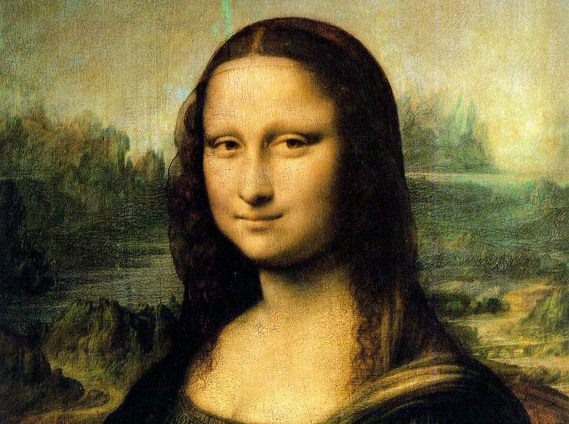
Looking for Faces in all the Right Places
Quick HD Calculations
Search square = 21 x 21
Pixels = 1920 x 1080 = 2,073,600
Search squares = 1900 x 1060 = ~2 Million
Notes:
Now lets analyze how it works, in the HAAR algorithm.

Slide 47
Looking for different size faces – by scaling the video frame
More HD Calculations
70% scaling in H and V
Total Pixels = 4.07 Million
Search squares = 3.8 Million

Slide 48
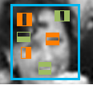
HAAR Cascade stages
Feature k
Feature l
Stage N
Feature m
Face still
possible?
Yes
Feature p
No
Feature r
Stage N+1
Feature q
REJECT
FRAME
Notes:
Now, just what do we do in each of those search boxes?

Slide 49
22 cascade stages, early out between each
STAGE 1
STAGE 2
STAGE 21
STAGE 22
FACE CONFIRMED
NO FACE
Final HD Calculations
Search squares = 3.8 million
Average features per square = 124
Calculations per feature = 100
Calculations per frame = 47 GCalcs
Calculation Rate
30 frames/sec = 1.4TCalcs/second
60 frames/sec = 2.8TCalcs/second
…and this only gets front-facing faces
Notes:
Each successive cascade stage searches for more features.
- Initial cascade stage is cheap, each successive cascade stage is more expensive
Exit from a cascade stage means a face is not present in the rectangle
Surviving all the cascades confirms a face is present
This is a nested data parallel opportunity:
Significant chunks of parallel code in control flow

Slide 50
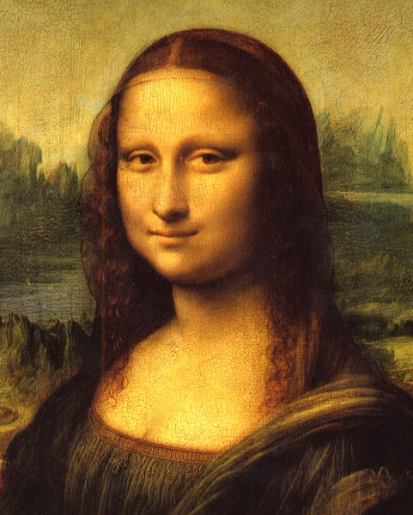
Cascade Depth Analysis
Notes:
Here is a 3D graph of the cascade depth used when searching for the face in the Mona Lisa
Note that most of the searches exit in 5 cascade stages or fewer
A considerable number run between 5-10.
And we see the broad pillar that represents the face, where all 22 stages returned a positive results.
This is not a classically data parallel workload. Far from it.

Slide 51
Processing Time/Stage
Cascade Stage
AMD A10 4600M APU with Radeon™ HD Graphics; CPU: 4 cores @ 2.3 MHz (turbo 3.2 GHz); GPU: AMD Radeon HD 7660G,
6 compute units, 685MHz; 4GB RAM; Windows 7 (64-bit); OpenCL™ 1.1 (873.1)
Notes:
Here we see what happens as more and more work items exit on each cascade stage.
In the first stage, the GPU is fully loaded and more than 5 times as fast as the CPU.
For the next few stages, it is close, and the CPU is clearly better at the latter stages.
How best to run this workload?
Run early stages on the GPU, and later stages on the CPU
Run each workload where it is most power efficient!
HSA allows this since we are in shared coherent memory

Slide 52
Performance CPU-vs-GPU
AMD A10 4600M APU with Radeon™ HD Graphics; CPU: 4 cores @ 2.3 MHz (turbo 3.2 GHz); GPU: AMD Radeon HD 7660G,
6 compute units, 685MHz; 4GB RAM; Windows 7 (64-bit); OpenCL™ 1.1 (873.1)
Notes:
In this graph we show the range of performance and power savings possible by running the first N stages on the GPU, followed by the rest on the CPU.
Note that running all on the CPU or all on the GPU, gets a similar bad result.
If we run the first 3 stages on the GPU, then switch to the CPU, we get the best result.
Note even though this is running fewer stages on the GPU, most of the search squares have exited by the time we switch to the CPU.

Slide 53
HAAR Solution – Run different cascades on GPU and CPU
By seamlessly sharing data between CPU and GPU,
HSA allows the right processor to handle its appropriate workload
+2.5x
-2.5x
INCREASED
PERFORMANCE
DECREASED ENERGY
PER FRAME
Notes:
And here is the result.
Performance more than doubles, and we process each frame with 40% of the power on average.
HSA allows the right processor …

Slide 54
Accelerating Memcached
Cloud Server Workload

Slide 55
MEMCACHED
A Distributed Memory Object Caching System Used in Cloud Servers
Generally used for short-term storage and caching, handling requests that would otherwise require database or file system accesses
Used by Facebook, YouTube, Twitter, Wikipedia, Flickr, and others
Effectively a large distributed hash table
  Responds to store and get requests received over the network
  Conceptually:
    store(key, object)
    object = get(key)

Slide 56
Offloading Memcached Key Lookup to the GPU
100%
80%
60%
40%
20%
0
Multithreaded CPU
Radeon HD 5870
“Trinity” A10-5800K
Zacate E-350
T. H. Hetherington, T. G. Rogers, L. Hsu, M. O’Connor, and T. M. Aamodt, “Characterizing and Evaluating a Key-Value Store Application on Heterogeneous CPU-GPU Systems,” Proceedings of the 2012 IEEE International Symposium on Performance Analysis of Systems and Software (ISPASS 2012), April 2012.
http://ieeexplore.ieee.org/xpl/articleDetails.jsp?tp=&arnumber=6189209
Notes:
This chart is taken from a paper published earlier this year by the UBC, in collaboration with AMD.
What it shows is that the GPUs in an APU can accelerate the key look up stage of Memached, by 2-3x, relative to their onboard CPUs.
We see this for both the mainstream trinity APU and the low power Zacate APU.
Why is the APU able to shine here while the discrete GPU struggles?
Look at the execution breakdown.
A discrete GPU is not a good choice for this algorithm, due to the data transfers across the PCIE bus dominating execcution time.
The APUs meanwhile are emulating HSA, using a driver optimization called “Zero Copy”. So the APU is able to operate on the data in place, and perform lots of look ups in parallel, much faster than the CPU. This is how HSA will work, except the programming will be easier and not require several PHDs to complete it.

Slide 57
Accelerating B+Tree Searches
Cloud Server Workload

Slide 58
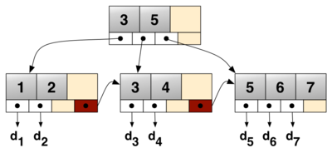
B+Tree searches
B+Trees are a fundamental data structure
  Used to reduce memory & disk access to locate a key
  Can support index- and range-based queries
  Can be updated efficiently
B+Trees are used by enterprise DB applications
  SQL: SQLite, MySQL, Oracle, and others
  No-SQL: Apache CouchDB, Tokyo Cabinet, and others
    Audio search, video copy detection
A simple B+Tree linking the keys 1-7. The linked list (red) allows rapid in-order traversal.

Slide 59
Parallel B+Tree Searches on HSA
By efficiently sharing data between CPU and GPU, HSA increases performance versus Multi Threaded CPU, even for tree structures that reside in host memory.
With HSA, DB can be larger than GPU memory, and can be shared.
HSA lets us move compute to data
  Parallel search can move to GPU
  Sequential updates can remain on CPU
+4x
Platform | Size < 1.5 GB | Size 1.5-2.7 GB | Size > 2.7 GB
dGPU (memory size = 3GB) | ✓ | ✓ | ✗
HSA | ✓ | ✓ | ✓
INCREASED PERFORMANCE
M. Daga, and M. Nutter, “Exploiting Coarse-Grained Parallelism in B+Tree Searches on an APU”, Accepted at ”Second Workshop on Irregular Applications: Algorithms and Architectures, (IA3)” November 2012.
AMD A10 4600M APU with Radeon™ HD Graphics; CPU: 4 cores @ 2.3 MHz (turbo 3.2 GHz); GPU: AMD Radeon HD 7660G, 6 compute units, 685MHz; 4GB RAM

Slide 60
Accelerating Java
Going beyond native languages

Slide 61



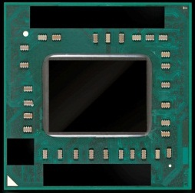

Java Enablement by APARAPI
Aparapi = Runtime capable of converting Java™ bytecode to OpenCL™
Developer creates Java™ source
For execution on any
OpenCL™ 1.1+ capable device
Source compiled to class files (bytecode) using standard compiler
OR execute via a thread pool if OpenCL™ is not available
final int[] in=getData();
final int[] out= new int[in.length];
Kernel kernel = new Kernel(){
@Override public void run(){
int id = getGlobalId(0);
out[id] = in[id]*in[id];
}
};
kernel.execute(in.length);
CPU THREADS
__kernel void run(
_global int *in,
_global int *out){
int id = get_global_id(0);
out[id] = in[id]*in[id];
}
Notes:
We have already released APARAPI, an acceleration library for Java, layered on OpenCL.
The idea behind APARAPI is to allow a write once, run anywhere, solution for Java that does not require the programmer to learn a new language.
We supply a library with a kernel class, that the Java programmer can override with their own Java code.
Then at runtime, the APARAPI library converts that bytecode to OpenCL, or to a thread pool if an OpenCL device is not available.
This has proven popular with the Java community.

Slide 62
JaVA aND APARAPI HSA ENABLEMENT ROADMAP
JVM
JVM
JVM
HSA-Enabled JVM
Application
Application
Application
Application
APARAPI
APARAPI
APARAPI
IR
HSA Runtime
LLVM Optimizer
HSAIL
HSAIL
HSAIL
OpenCL™
HSA Finalizer
HSA Finalizer
HSA Finalizer
CPU ISA
GPU ISA
CPU ISA
GPU ISA
CPU ISA
GPU ISA
CPU ISA
GPU ISA
CPU
GPU
HSA CPU
HSA GPU
HSA CPU
HSA GPU
HSA CPU
HSA GPU
Notes:
What might the HSA roadmap look like for Java and Aparapi?
The important thing is we can convert to HSA and offer performance improvement without requiring Aparapi users to change their Java code.
For non-HSA platforms we will still maintain our current OpenCL based solutions.
Refactor ‘bytecode to OpenCL engine to generate HSAIL
Remove OpenCL™ dependency
Enable use of HSA features not available through OpenCL™
Refactor ‘bytecode to OpenCL™’ engine to generate LLVM-IR
Leverage HSA Runtime’s ability to create optimized HSAIL
Demonstrate performance + ease of use for Java workloads
Our hope is of course that we can push HSA into the JVM itself and generate HSAIL directly from the Java Virtual Machine’s JIT.
Work with Java community to drive heterogeneous compute into mainstream applications
Enable frameworks and libraries (from desktop to ‘Big Data’)

Slide 63
EASE Of Programming
Code Complexity vs. Performance

Slide 64
Bolt
Optimized template library routines for common GPU functions
  For OpenCL™ and C++ AMP, across multiple platforms
Programming model interface similar to multicore Task Parallel Runtimes (TBB, ConCRT)
CPU performance as good or better than multicore Task Parallel Runtimes
Excellent performance and power efficiency on HSA Devices
For many applications, single source code base for both CPU and GPU !
Leverage robust Visual Studio C++AMP debug solution
Will appeal to developers not yet on GPU, or porting from CUDA/Thrust

Slide 65
Lines-of-Code AND PERFORMANCE For Different Programming Models
(Exemplary ISV “Hessian” Kernel)
35.00
30.00
Init.
25.00
Launch
Compile
20.00
Compile
Performance
Copy
Copy
15.00
Launch
Launch
Launch
Launch
Algorithm
10.00
Launch
Algorithm
Algorithm
Algorithm
Launch
5.00
Algorithm
Algorithm
Algorithm
Copy-back
Copy-back
Copy-back
0
Serial CPU TBB Intrinsics+TBB OpenCL™-C OpenCL™ -C++ C++ AMP HSA Bolt
Copy-back
Algorithm
Launch
Copy
Compile
Init
Performance
AMD A10-5800K APU with Radeon™ HD Graphics – CPU: 4 cores, 3800MHz (4200MHz Turbo); GPU: AMD Radeon HD 7660D, 6 compute units, 800MHz; 4GB RAM.
Software – Windows 7 Professional SP1 (64-bit OS); AMD OpenCL™ 1.2 AMD-APP (937.2); Microsoft Visual Studio 11 Beta
Notes:
Key Points:
Writing optimal CPU implementations requires complex development too.
Programmers have to use both intrinsics for vector parallelism, and TBB for multicore parallelism.
OpenCL C
OpenCL-C is widely known fairly verbose C-based API, and it shows in the boilerplate initialization code, runtime-compile code, and kernel launch.
OpenCL C++ :
Removes initialization code by providing sensible defaults for platform, context, device, command-queue. No need to set these up, and no need to save them and drag them around for later OCL API calls.
Reduce code to compile by using C++ exceptions for error-checking, automatic memory allocation (rather than calling API to determine size of return args)
Default arguments, type-checking – code focuses on relevant parameters.
The host-side support for C++ is available in a “cl.hpp” file which runs on any OpenCL implementation (including NV, Intel, etc).
In addition, AMD OpenCL implementation supports “static” C++ kernel language – classes, namespaces, templates. (Not used in the this implementation).
C++ AMP
Initialization is handled through sensible defaults. C++AMP eliminates platform, context, accelerator_view combines device and queue.
Single-source model : Eliminates run-time compile code, this is done at compile-time with the host code.
Single-source model : streamlined kernel call convention (eliminate clSetKernelArg)
The implementation here uses C++11 lambda to reduce boilerplate code for functor construction (kernel can directly access local vars)
Data xfer reduced by implicit transfers performed by array_view
BOLT
Moves reduction code into library - what’s left is reduction operator.
Removes data xfer and copy-back – interface is directly with host data structures.
Bolt-for-C++AMP uses lambda syntax; Bolt-For-OCL does not (not supported)
Bolt-for-OCL implementation relies on C++ static kernel language – recently introduced in AMD APP SDK 2.6 (beta) and 2.7 (production?)
Other notes:
Serial CPU integrates algorithm and reduction and we call it just “algorithm” ; later implementations separate these for performance.
Launch is argument setup and calling of the kernel or library routine.
Copy-back includes code to copy data back to host and run a host-side final reduction step.
LOC includes appropriate spaces and comments. We attempted to use similar coding style across all implementations.
Tbb init is 1-line to initialize the scheduler. (tbb::task_scheduler_init)

Slide 66
Research Topics in HSA
Category | Description | Comments
Languages/Compilers | Higher-level languages. GPU languages are primitive today. OpenCL is a good expert tool. Look into domain specific languages (graphics, math). Ex: HSA could have a database accelerator component
 | Split compilation model – high level compliers & low level compilers and how to make them work well together
 | How to run best on a device with multi ISA’s
Software Run-Time | Classic load balancing. Look for new ways to partition algorithms automatically in the runtime. Simultaneous running of multiple kernels or multiple applications. Quality of service & virtualization. Scheduling for complex status graphs and scheduling dynamic parallelism
System Architecture | Bandwidth/memory arch (balancing BW with compute) Load balancing Memory configurations: Stack memory devices will eventually appear and systems will change around idea of bandwidth. Shared memory stacks – what are the implications? TCU/LCU ratios
Hardware | Logical split between split function hardware. Applying HSA to non-GPU devices (DSPs, FPGAs, etc.) Heterogeneous conformance optimization - how to run a program that runs well on all different HSA platforms and hardware
 | Memory system design: low cost support for coherency and would give programmers a way to optimize their use of coherence
 | Security: looking into securing systems
 | Efficient synchronization primitives
 | 3D graphics pipes – integration with HSA

Slide 67
the HSA Opportunity for developer
SOLUTION
PROBLEM
HSA + Libraries =
productivity & performance with low power
Het. systems hard to program
Not all workloads accelerate
Developer
Return
(Differentiation in
performance,
reduced power,
features,
time to market)
Few M
HSA
coders
Few 100Ks
HSA
apps
Wide range of
differentiated
experiences
~100K
GPU
coders
~200
apps
Significant niche
value
PROBLEM
Historically, developers program CPUs
20+M*
CPU
coders
~4M
apps
Good user
experiences
Developer Investment
(Effort, time, new skills)
*IDC
Notes:
Opening (just the axes)
“Let’s take a look at the cost versus return facing programmers today when developing modern applications.”
Click (bottom left red “Problem/CPU” build comes up)
“There are 10M CPU coders today, delivering millions of applications and good user experiences, but when they code their parallel content on the CPU, it runs slower and draws more power than it should”.
Click (top right red “Problem/GPU” build comes up)
“Today there are 10s of thousands of GPU coders around the world, perhaps as many as 100K. These expert programmers, through careful partitioning of the right sections of parallel code, and management of data copies … can extract a better user experience … but it’s still too hard and costs too much.”
Click (top left green “Solution/HSA” build comes up)
“The solution is HSA and its libraries. Opening up the platform rapidly to more than a million programmers, resulting in hundreds of thousands of applications and a range of differentiated experiences. The key is making the platform easy to program. Did I mention that?”

